Slide 1
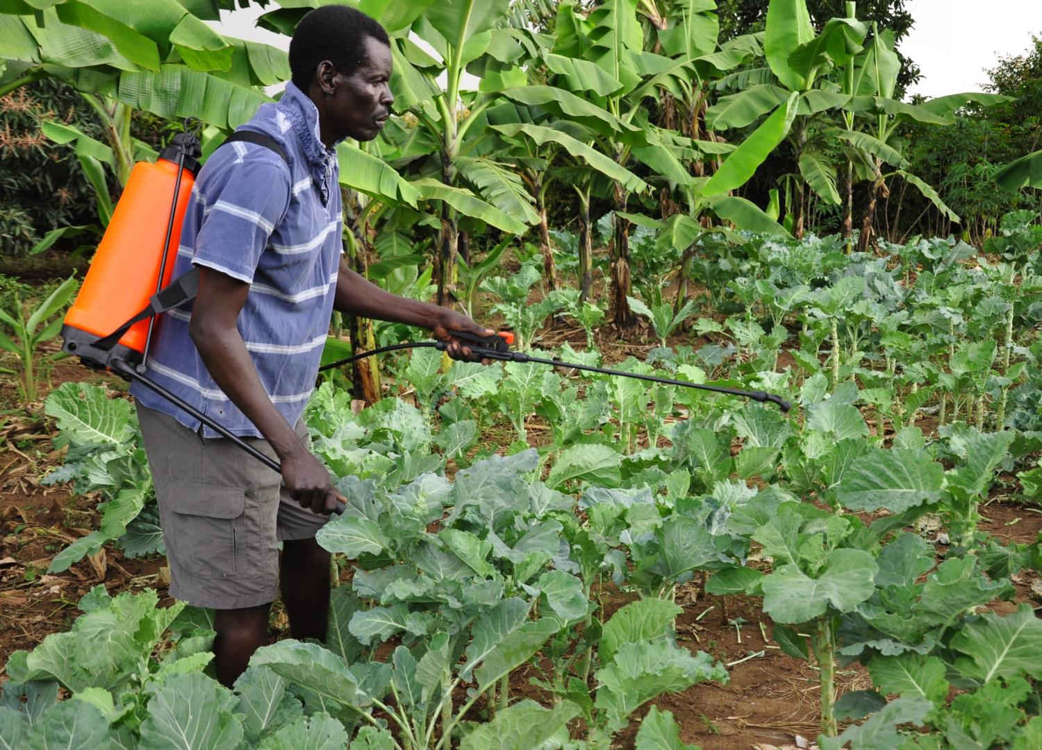
MODULE 2
PLANT HEALTHCARE
Phil Taylor and
Rob Reeder, CABI
10. SAFE USE OF PESTICIDES
© CAB International 2012
PLANTWISE TRAINING. MODULE 2: PLANT HEALTHCARE. SAFE USE OF PESTICIDES
Notes:
Presentation pretty much speaks for itself. Hazards not included are keeping children and animals out of the spray area and considerations regarding the weather.
This very much focusses on the operator exposure and you must emphasise that there are many other ways pesticides can damage things and people: consumers, animals, environment to name a few, this will be covered in a class exercise later in the training.
PPE in this picture is lacking.

Slide 2
Care should always be taken when handling and applying pesticides.
Plant doctors have a duty to inform farmers of the hazards and correct means of handling chemical substances.
Please watch the following presentation carefully noting down potential problems. Only record each problem once!
INTRODUCTION
PLANTWISE TRAINING. MODULE 2: PLANT HEALTHCARE. SAFE USE OF PESTICIDES
Notes:
Judge from students’ reactions how fast they are noting answers and determine how to proceed. Don’t expect the trainees to write down every single one. Some of the “errors” such as pouring from a height are rather difficult.

Slide 3
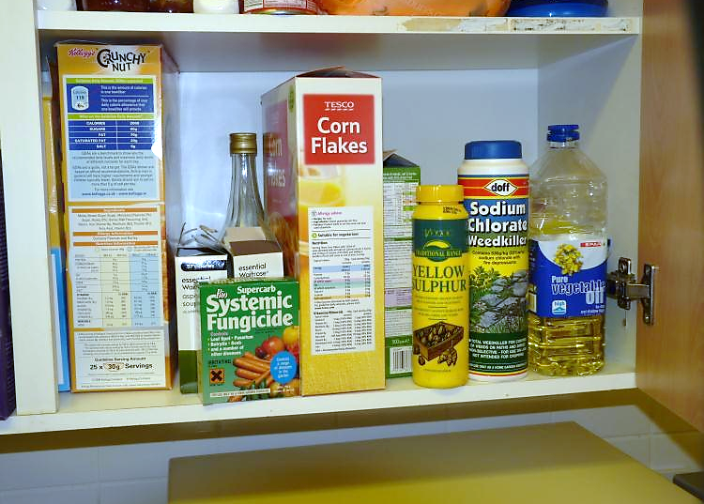
FIND THE PROBLEM
PLANTWISE TRAINING. MODULE 2: PLANT HEALTHCARE. SAFE USE OF PESTICIDES : EXERCISE

Slide 4
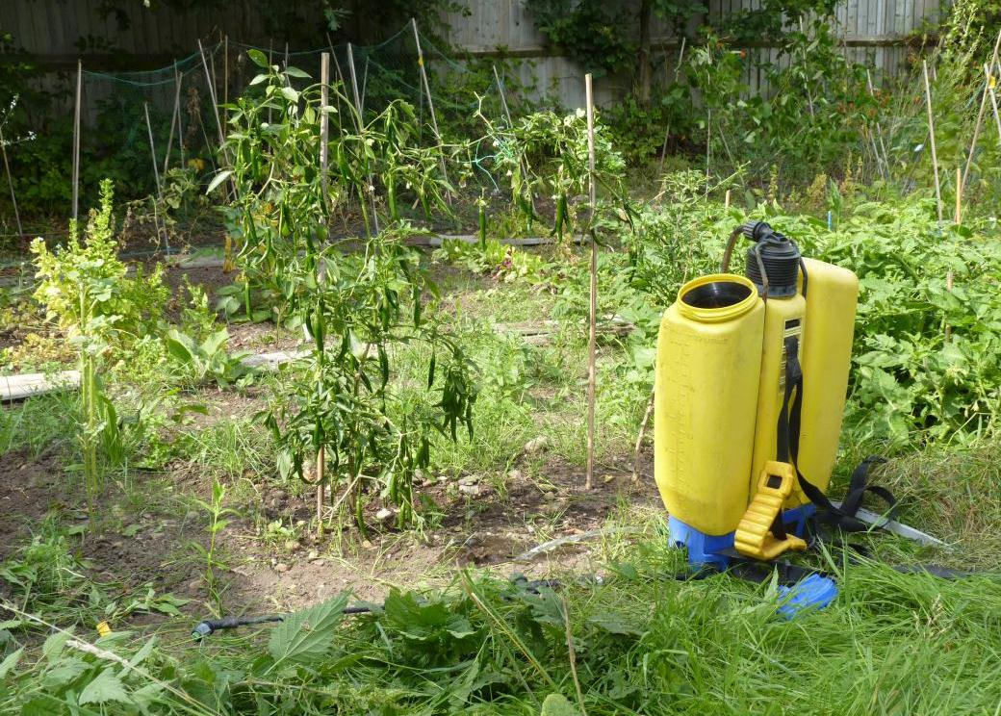
FIND THE PROBLEM
PLANTWISE TRAINING. MODULE 2: PLANT HEALTHCARE. SAFE USE OF PESTICIDES : EXERCISE

Slide 5
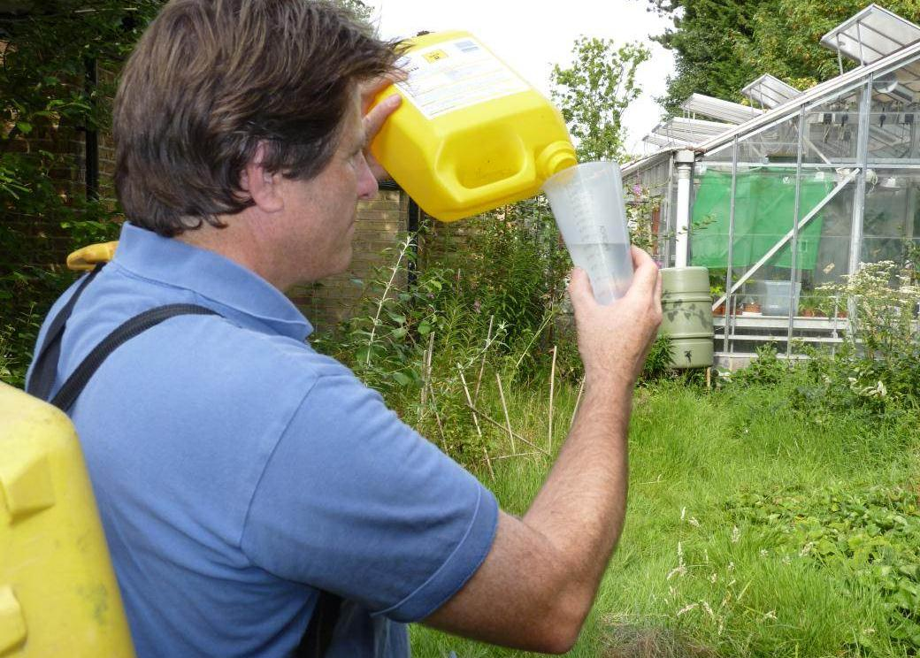
FIND THE PROBLEM
PLANTWISE TRAINING. MODULE 2: PLANT HEALTHCARE. SAFE USE OF PESTICIDES : EXERCISE

Slide 6
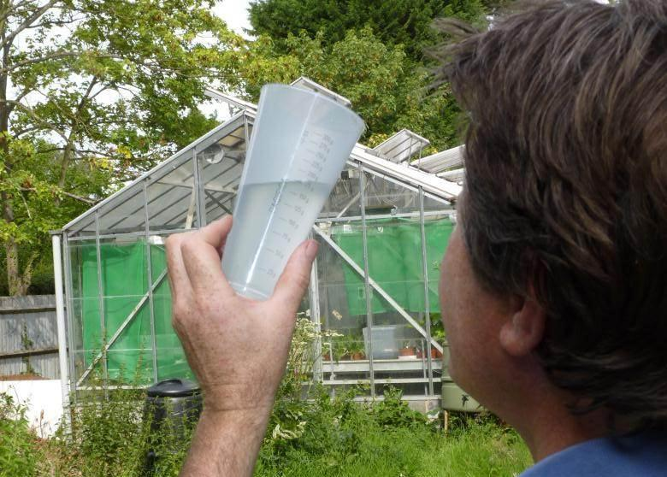
FIND THE PROBLEM
PLANTWISE TRAINING. MODULE 2: PLANT HEALTHCARE. SAFE USE OF PESTICIDES : EXERCISE

Slide 7
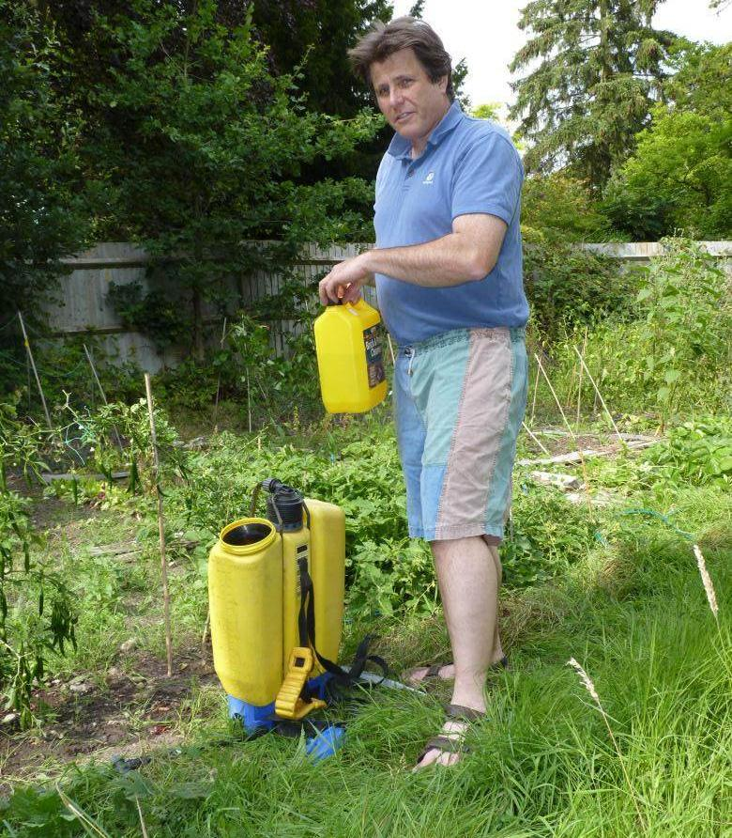
FIND THE PROBLEM
PLANTWISE TRAINING. MODULE 2: PLANT HEALTHCARE. SAFE USE OF PESTICIDES : EXERCISE

Slide 8
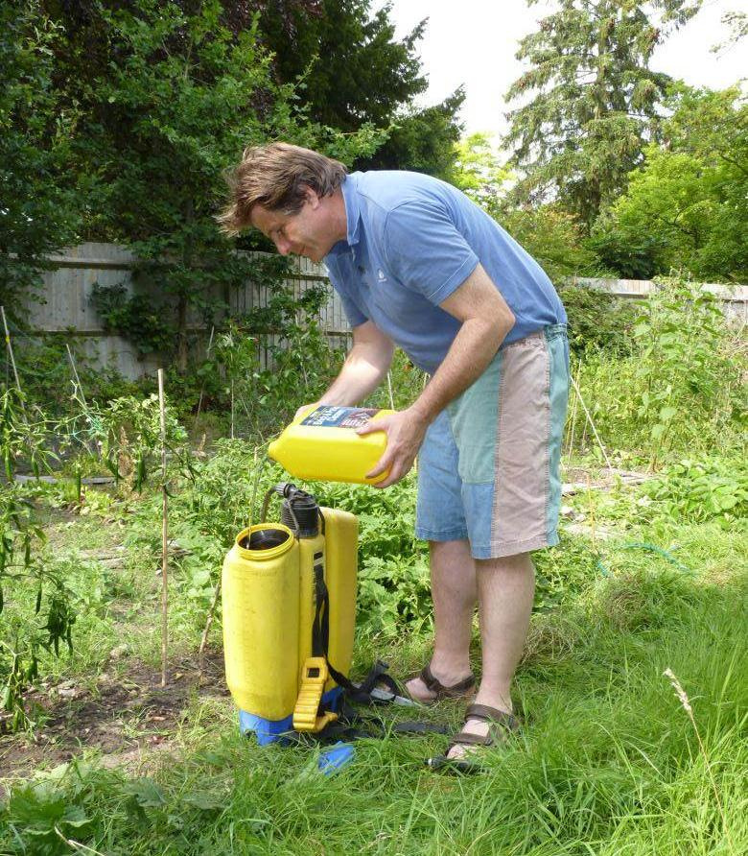
FIND THE PROBLEM
PLANTWISE TRAINING. MODULE 2: PLANT HEALTHCARE. SAFE USE OF PESTICIDES : EXERCISE

Slide 9
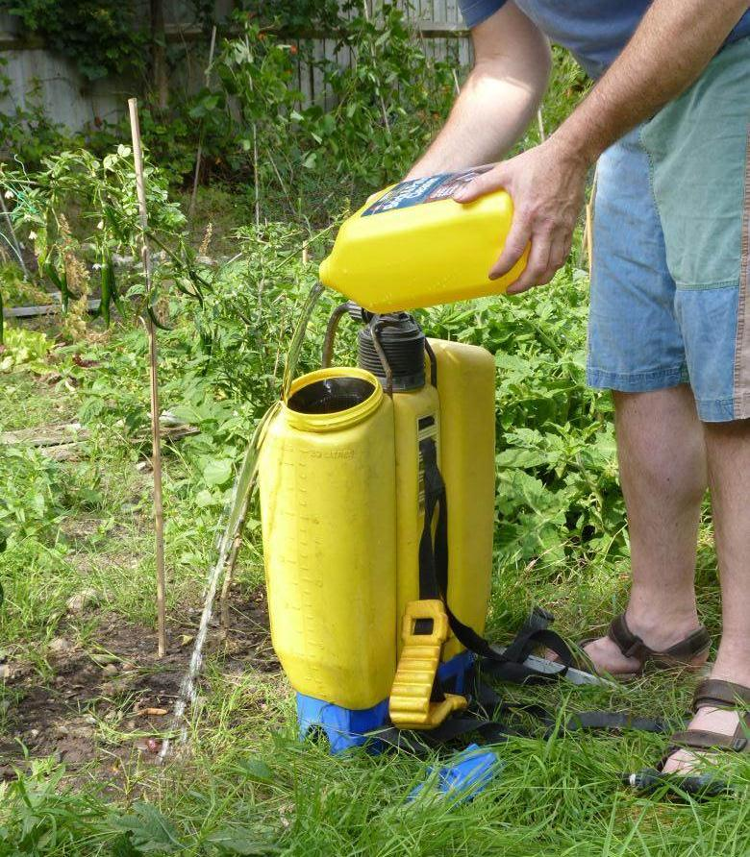
FIND THE PROBLEM
PLANTWISE TRAINING. MODULE 2: PLANT HEALTHCARE. SAFE USE OF PESTICIDES : EXERCISE

Slide 10
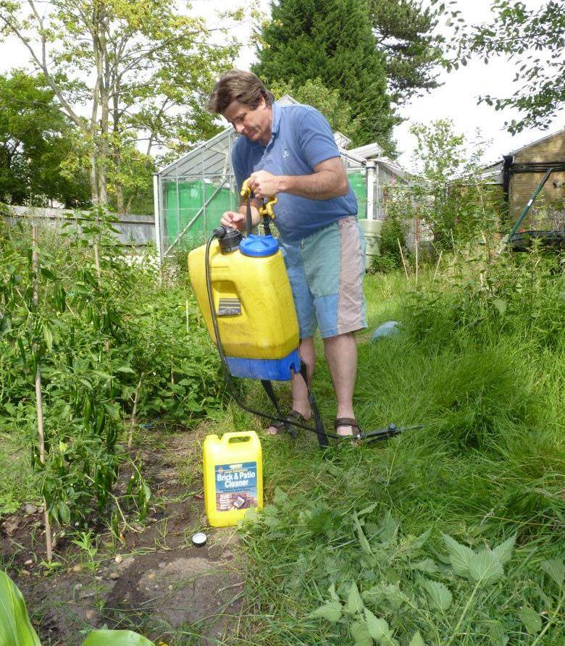
FIND THE PROBLEM
PLANTWISE TRAINING. MODULE 2: PLANT HEALTHCARE. SAFE USE OF PESTICIDES : EXERCISE

Slide 11
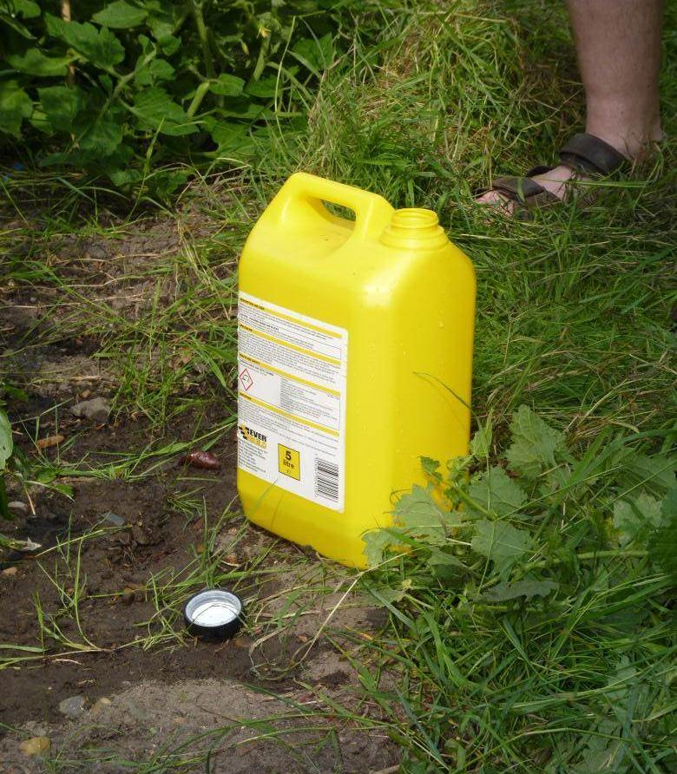
FIND THE PROBLEM
PLANTWISE TRAINING. MODULE 2: PLANT HEALTHCARE. SAFE USE OF PESTICIDES : EXERCISE

Slide 12
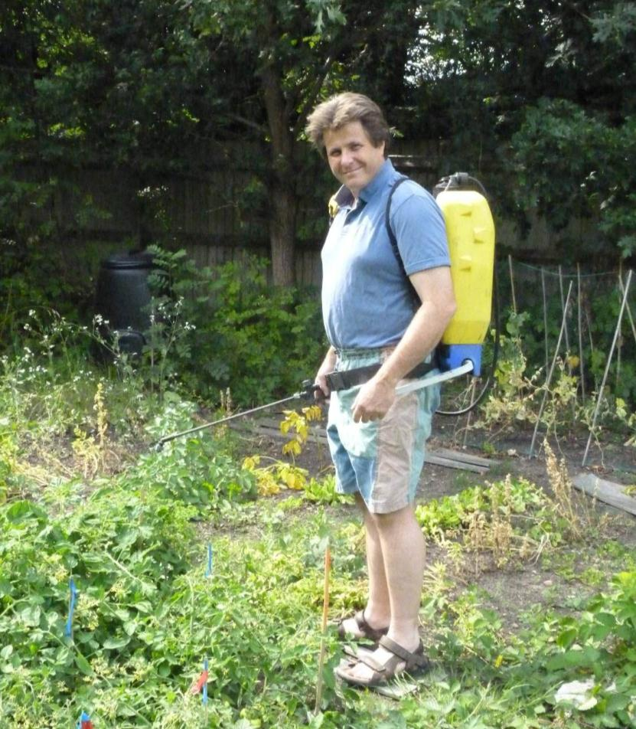
FIND THE PROBLEM
PLANTWISE TRAINING. MODULE 2: PLANT HEALTHCARE. SAFE USE OF PESTICIDES : EXERCISE

Slide 13
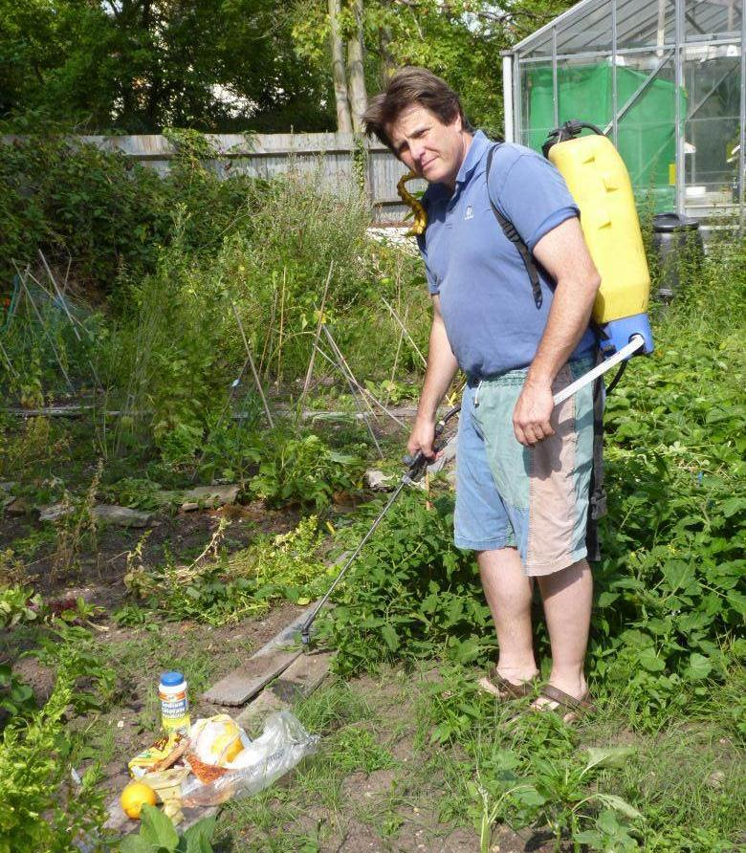
FIND THE PROBLEM
PLANTWISE TRAINING. MODULE 2: PLANT HEALTHCARE. SAFE USE OF PESTICIDES : EXERCISE

Slide 14
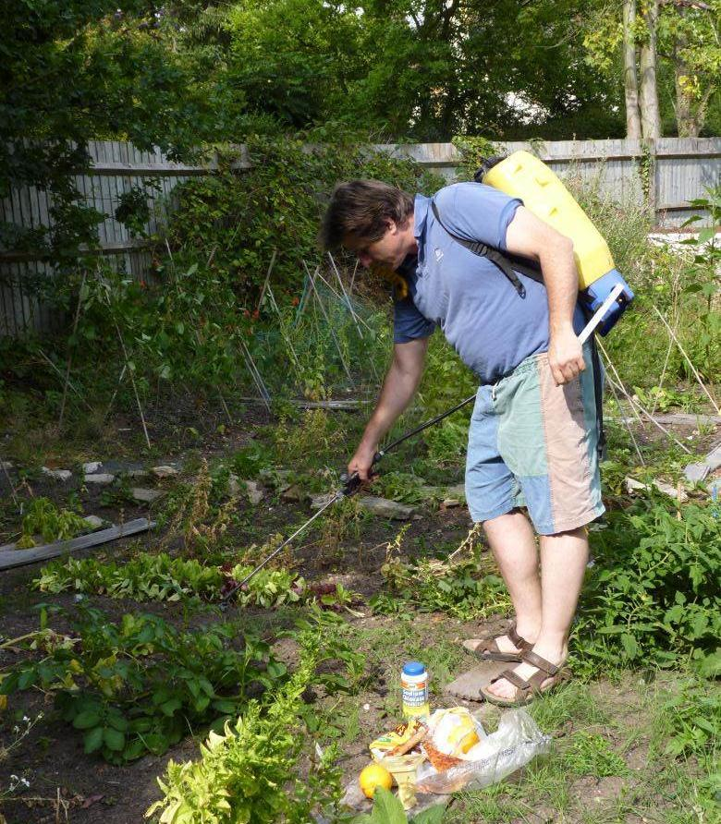
FIND THE PROBLEM
PLANTWISE TRAINING. MODULE 2: PLANT HEALTHCARE. SAFE USE OF PESTICIDES : EXERCISE

Slide 15
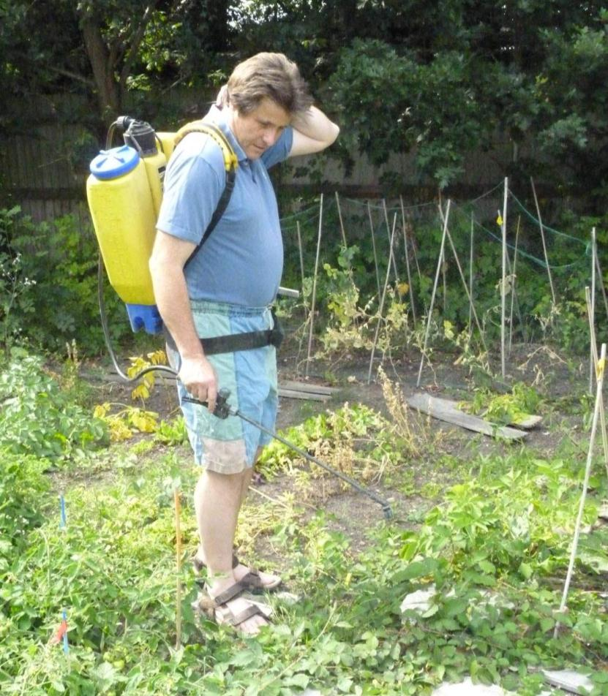
FIND THE PROBLEM
PLANTWISE TRAINING. MODULE 2: PLANT HEALTHCARE. SAFE USE OF PESTICIDES : EXERCISE

Slide 16
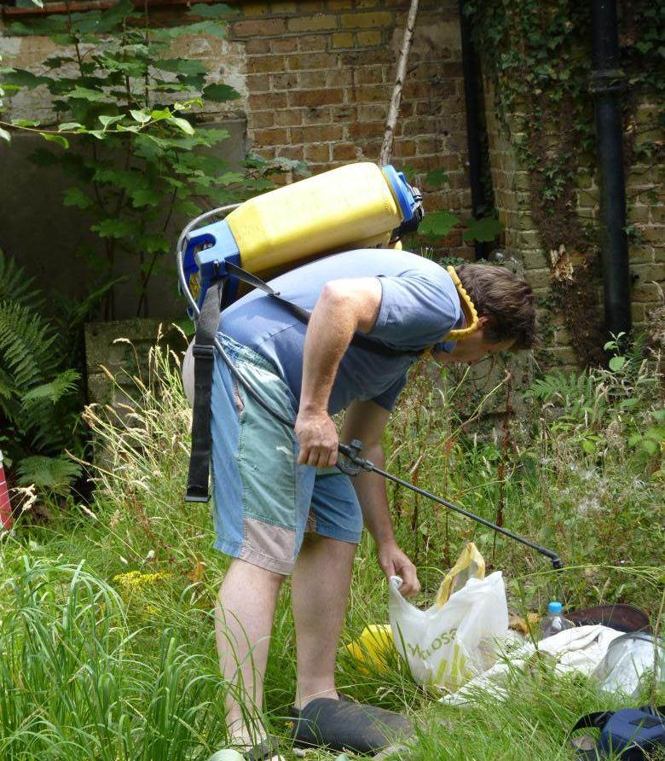
FIND THE PROBLEM
PLANTWISE TRAINING. MODULE 2: PLANT HEALTHCARE. SAFE USE OF PESTICIDES : EXERCISE
Notes:
Bending over with a knapsack sprayer is not a good thing to do but

Slide 17
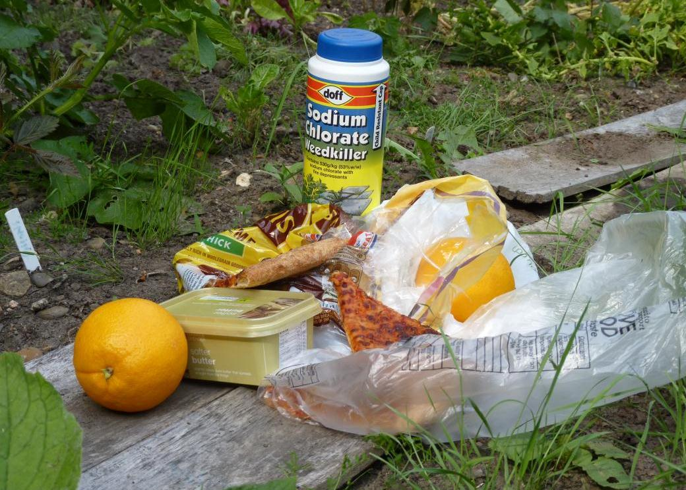
FIND THE PROBLEM
PLANTWISE TRAINING. MODULE 2: PLANT HEALTHCARE. SAFE USE OF PESTICIDES : EXERCISE

Slide 18
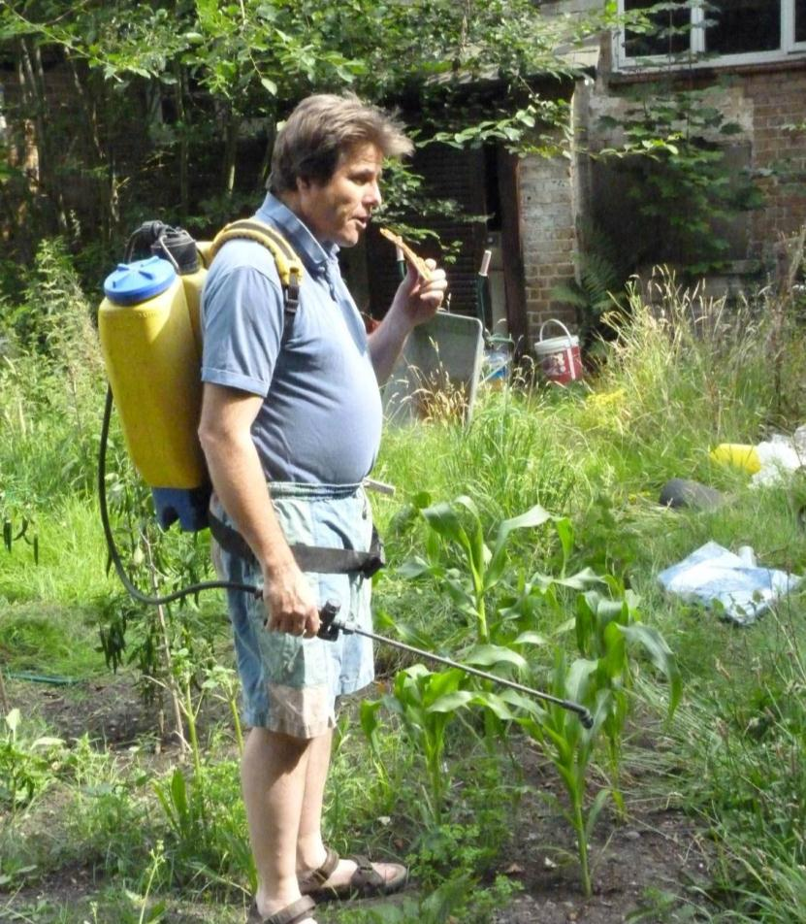
FIND THE PROBLEM
PLANTWISE TRAINING. MODULE 2: PLANT HEALTHCARE. SAFE USE OF PESTICIDES : EXERCISE

Slide 19
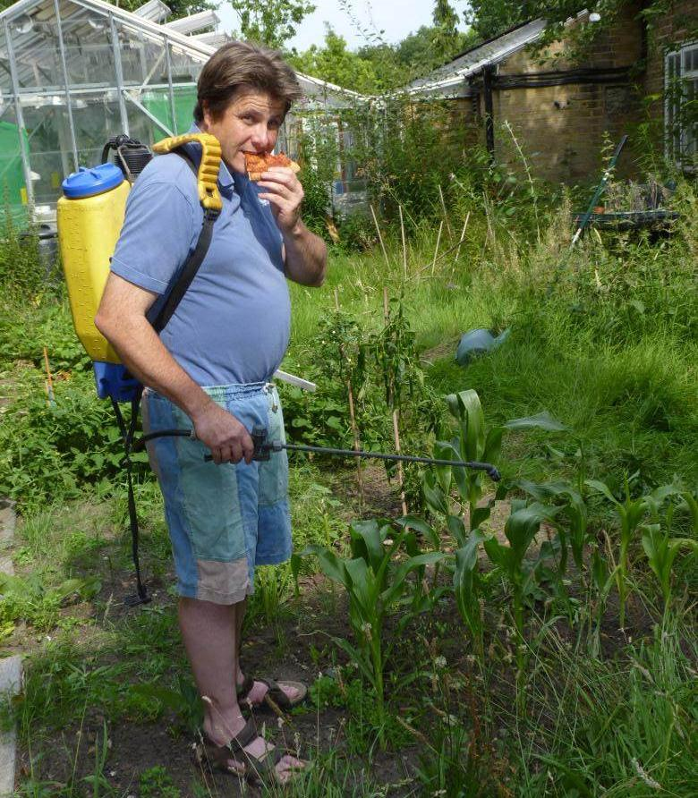
FIND THE PROBLEM
PLANTWISE TRAINING. MODULE 2: PLANT HEALTHCARE. SAFE USE OF PESTICIDES : EXERCISE

Slide 20
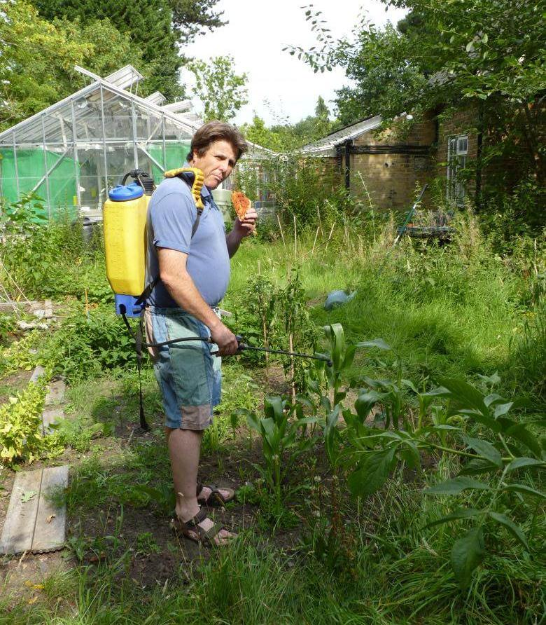
FIND THE PROBLEM
PLANTWISE TRAINING. MODULE 2: PLANT HEALTHCARE. SAFE USE OF PESTICIDES : EXERCISE

Slide 21
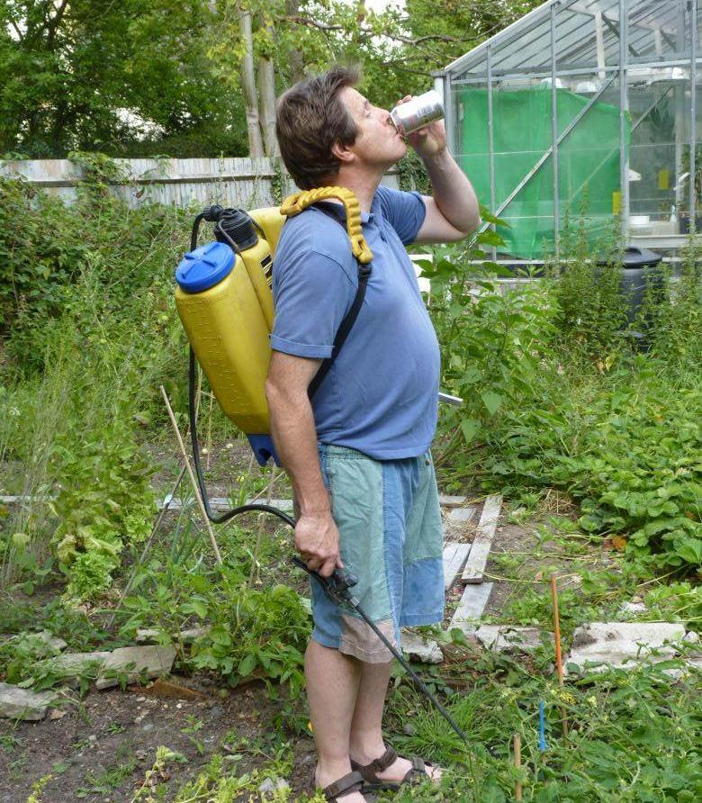
FIND THE PROBLEM
PLANTWISE TRAINING. MODULE 2: PLANT HEALTHCARE. SAFE USE OF PESTICIDES : EXERCISE

Slide 22
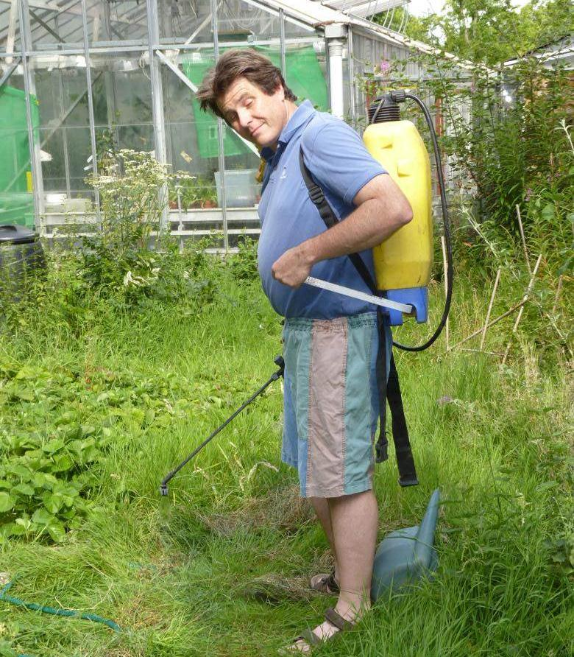
FIND THE PROBLEM
PLANTWISE TRAINING. MODULE 2: PLANT HEALTHCARE. SAFE USE OF PESTICIDES : EXERCISE

Slide 23
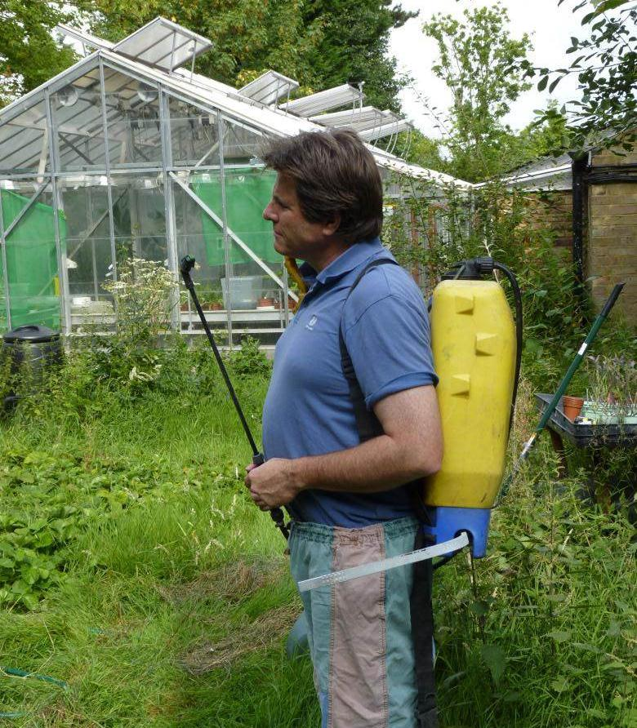
FIND THE PROBLEM
PLANTWISE TRAINING. MODULE 2: PLANT HEALTHCARE. SAFE USE OF PESTICIDES : EXERCISE

Slide 24
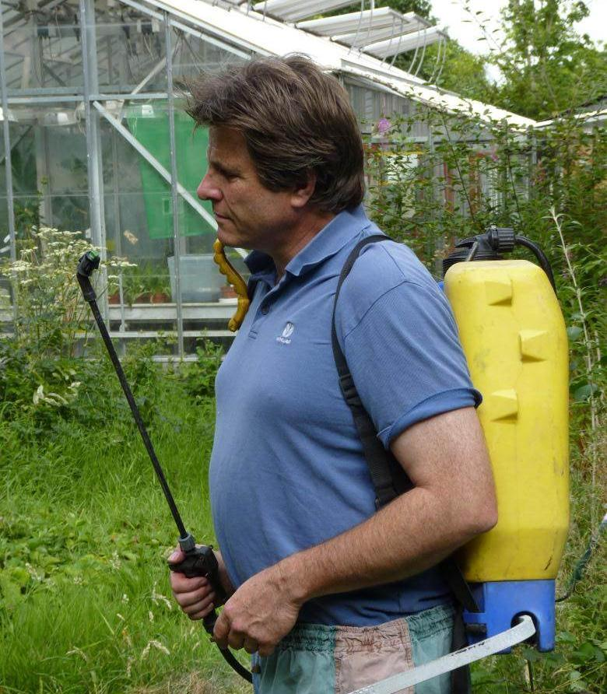
FIND THE PROBLEM
PLANTWISE TRAINING. MODULE 2: PLANT HEALTHCARE. SAFE USE OF PESTICIDES : EXERCISE

Slide 25
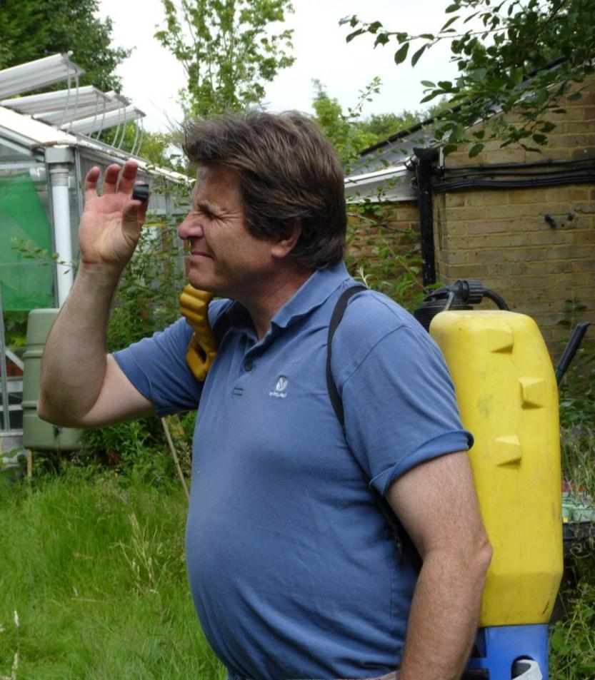
FIND THE PROBLEM
PLANTWISE TRAINING. MODULE 2: PLANT HEALTHCARE. SAFE USE OF PESTICIDES : EXERCISE

Slide 26
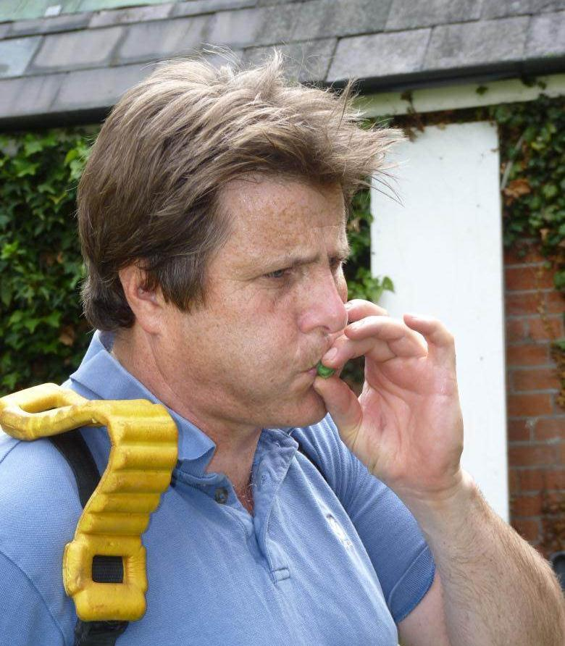
FIND THE PROBLEM
PLANTWISE TRAINING. MODULE 2: PLANT HEALTHCARE. SAFE USE OF PESTICIDES : EXERCISE

Slide 27
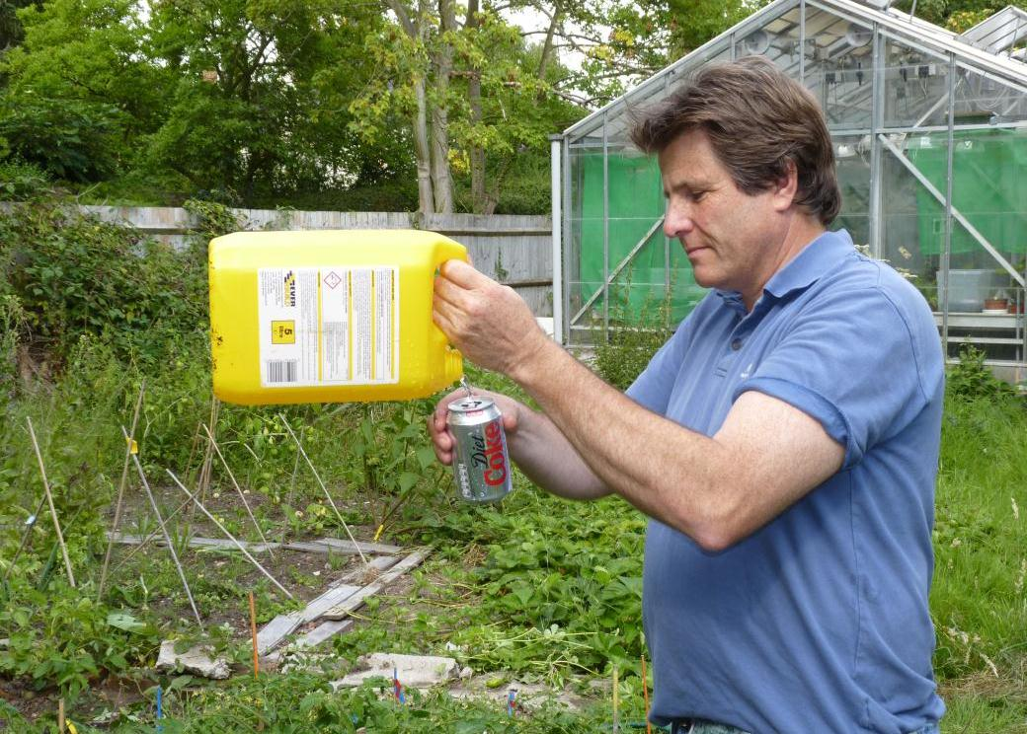
FIND THE PROBLEM
PLANTWISE TRAINING. MODULE 2: PLANT HEALTHCARE. SAFE USE OF PESTICIDES : EXERCISE

Slide 28
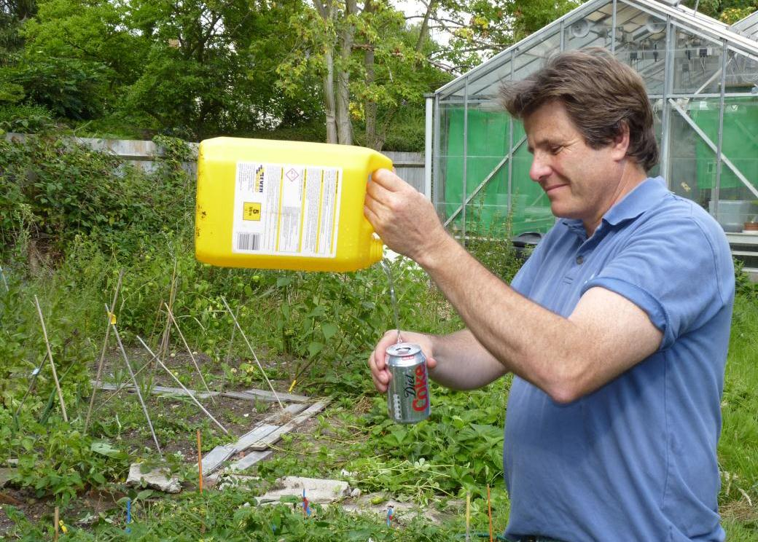
FIND THE PROBLEM
PLANTWISE TRAINING. MODULE 2: PLANT HEALTHCARE. SAFE USE OF PESTICIDES : EXERCISE

Slide 29
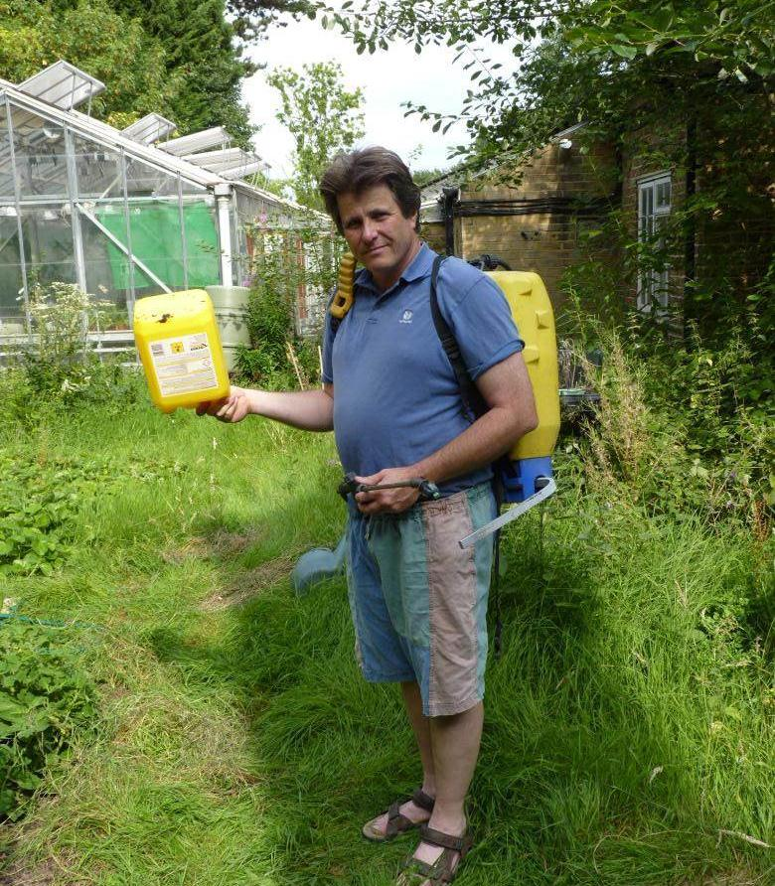
FIND THE PROBLEM
PLANTWISE TRAINING. MODULE 2: PLANT HEALTHCARE. SAFE USE OF PESTICIDES : EXERCISE

Slide 30
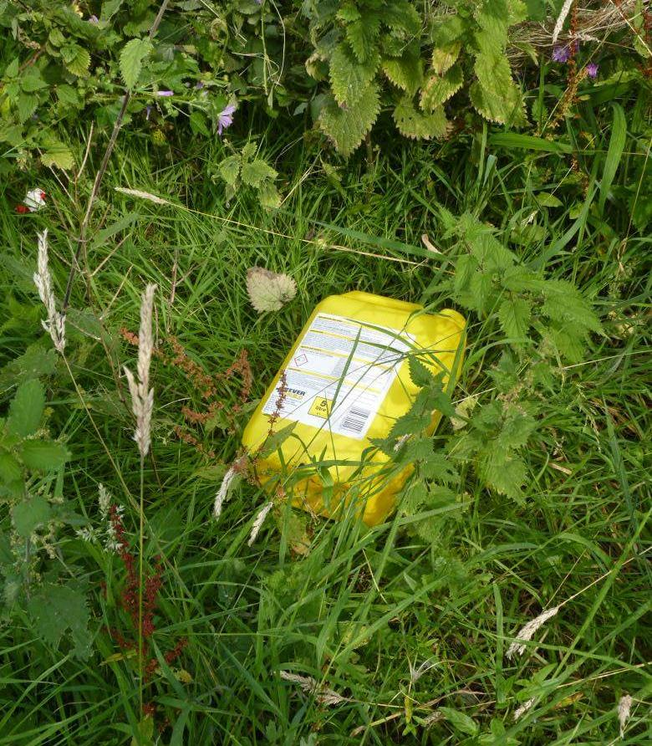
FIND THE PROBLEM
PLANTWISE TRAINING. MODULE 2: PLANT HEALTHCARE. SAFE USE OF PESTICIDES : EXERCISE

Slide 31
POTENTIAL PROBLEMS
How many did you spot?
WE COUNTED 19
PLANTWISE TRAINING. MODULE 2: PLANT HEALTHCARE. SAFE USE OF PESTICIDES : POTENTIAL PROBLEMS

Slide 32
POTENTIAL PROBLEMS
PLANTWISE TRAINING. MODULE 2: PLANT HEALTHCARE. SAFE USE OF PESTICIDES : POTENTIAL PROBLEMS

Slide 33
POTENTIAL PROBLEMS
PLANTWISE TRAINING. MODULE 2: PLANT HEALTHCARE. SAFE USE OF PESTICIDES : POTENTIAL PROBLEMS

Slide 34
POTENTIAL PROBLEMS
PLANTWISE TRAINING. MODULE 2: PLANT HEALTHCARE. SAFE USE OF PESTICIDES : POTENTIAL PROBLEMS

Slide 35
POTENTIAL PROBLEMS
PLANTWISE TRAINING. MODULE 2: PLANT HEALTHCARE. SAFE USE OF PESTICIDES : POTENTIAL PROBLEMS

Slide 36
POTENTIAL PROBLEMS
PLANTWISE TRAINING. MODULE 2: PLANT HEALTHCARE. SAFE USE OF PESTICIDES : POTENTIAL PROBLEMS

Slide 37
POTENTIAL PROBLEMS
PLANTWISE TRAINING. MODULE 2: PLANT HEALTHCARE. SAFE USE OF PESTICIDES : POTENTIAL PROBLEMS

Slide 38
POTENTIAL PROBLEMS
PLANTWISE TRAINING. MODULE 2: PLANT HEALTHCARE. SAFE USE OF PESTICIDES : POTENTIAL PROBLEMS

Slide 39
POTENTIAL PROBLEMS
PLANTWISE TRAINING. MODULE 2: PLANT HEALTHCARE. SAFE USE OF PESTICIDES : POTENTIAL PROBLEMS

Slide 40
POTENTIAL PROBLEMS
PLANTWISE TRAINING. MODULE 2: PLANT HEALTHCARE. SAFE USE OF PESTICIDES : POTENTIAL PROBLEMS

Slide 41
POTENTIAL PROBLEMS
PLANTWISE TRAINING. MODULE 2: PLANT HEALTHCARE. SAFE USE OF PESTICIDES : POTENTIAL PROBLEMS

Slide 42
POTENTIAL PROBLEMS
PLANTWISE TRAINING. MODULE 2: PLANT HEALTHCARE. SAFE USE OF PESTICIDES : POTENTIAL PROBLEMS

Slide 43
POTENTIAL PROBLEMS
PLANTWISE TRAINING. MODULE 2: PLANT HEALTHCARE. SAFE USE OF PESTICIDES : POTENTIAL PROBLEMS

Slide 44
POTENTIAL PROBLEMS
PLANTWISE TRAINING. MODULE 2: PLANT HEALTHCARE. SAFE USE OF PESTICIDES : POTENTIAL PROBLEMS

Slide 45
POTENTIAL PROBLEMS
PLANTWISE TRAINING. MODULE 2: PLANT HEALTHCARE. SAFE USE OF PESTICIDES : POTENTIAL PROBLEMS

Slide 46
POTENTIAL PROBLEMS
PLANTWISE TRAINING. MODULE 2: PLANT HEALTHCARE. SAFE USE OF PESTICIDES : POTENTIAL PROBLEMS

Slide 47
POTENTIAL PROBLEMS
PLANTWISE TRAINING. MODULE 2: PLANT HEALTHCARE. SAFE USE OF PESTICIDES : POTENTIAL PROBLEMS

Slide 48
POTENTIAL PROBLEMS
PLANTWISE TRAINING. MODULE 2: PLANT HEALTHCARE. SAFE USE OF PESTICIDES : POTENTIAL PROBLEMS

Slide 49
POTENTIAL PROBLEMS
PLANTWISE TRAINING. MODULE 2: PLANT HEALTHCARE. SAFE USE OF PESTICIDES : POTENTIAL PROBLEMS

Slide 50
POTENTIAL PROBLEMS
PLANTWISE TRAINING. MODULE 2: PLANT HEALTHCARE. SAFE USE OF PESTICIDES : POTENTIAL PROBLEMS

Slide 51
POTENTIAL PROBLEMS
PLANTWISE TRAINING. MODULE 2: PLANT HEALTHCARE. SAFE USE OF PESTICIDES : POTENTIAL PROBLEMS

Slide 52
POTENTIAL PROBLEMS
PLANTWISE TRAINING. MODULE 2: PLANT HEALTHCARE. SAFE USE OF PESTICIDES : POTENTIAL PROBLEMS

Slide 53
POTENTIAL PROBLEMS
PLANTWISE TRAINING. MODULE 2: PLANT HEALTHCARE. SAFE USE OF PESTICIDES : POTENTIAL PROBLEMS

Slide 54
POTENTIAL PROBLEMS
PLANTWISE TRAINING. MODULE 2: PLANT HEALTHCARE. SAFE USE OF PESTICIDES : POTENTIAL PROBLEMS

Slide 55
POTENTIAL PROBLEMS
PLANTWISE TRAINING. MODULE 2: PLANT HEALTHCARE. SAFE USE OF PESTICIDES : POTENTIAL PROBLEMS
Notes:
It is very tempting to do this but should avoided at all costs. Using clean water will help to prevent blockages

Slide 56
POTENTIAL PROBLEMS
PLANTWISE TRAINING. MODULE 2: PLANT HEALTHCARE. SAFE USE OF PESTICIDES : POTENTIAL PROBLEMS
Notes:
Storage in food containers is not acceptable

Slide 57
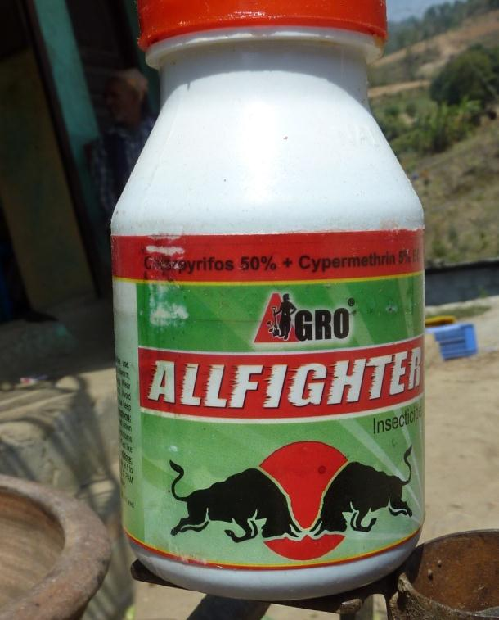

POTENTIAL PROBLEMS
PLANTWISE TRAINING. MODULE 2: PLANT HEALTHCARE. SAFE USE OF PESTICIDES : POTENTIAL PROBLEMS
Notes:
Be cautious of similar labels on chemical and food packages
(another reason NOT to store chemicals and food in the same place)

Slide 58
POTENTIAL PROBLEMS
PLANTWISE TRAINING. MODULE 2: PLANT HEALTHCARE. SAFE USE OF PESTICIDES : POTENTIAL PROBLEMS
Notes:
Pouring from height is not a good idea either.

Slide 59
POTENTIAL PROBLEMS
PLANTWISE TRAINING. MODULE 2: PLANT HEALTHCARE. SAFE USE OF PESTICIDES : POTENTIAL PROBLEMS

Slide 60
POTENTIAL PROBLEMS
PLANTWISE TRAINING. MODULE 2: PLANT HEALTHCARE. SAFE USE OF PESTICIDES : POTENTIAL PROBLEMS
Notes:
We recommend that the pesticide containers are washed out at least three times and then burnt on a bonfire. Do not produce a smouldering smokey burning plastic fire. Avoid inhaling the smoke when you do burn them.
In the UK they are recycled although burning was the recommended method of disposal until a few years ago. If recycling facilities do exist (genuine recycling and not just washed out and sold for water transport) then use them.

Slide 61
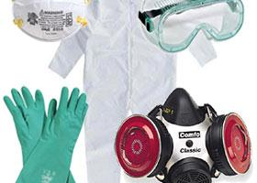
PROTECTIVE GEAR
What’s available and how much does it cost?
PLANTWISE TRAINING. MODULE 2: PLANT HEALTHCARE. SAFE USE OF PESTICIDES : PROTECTIVE GEAR

Slide 62
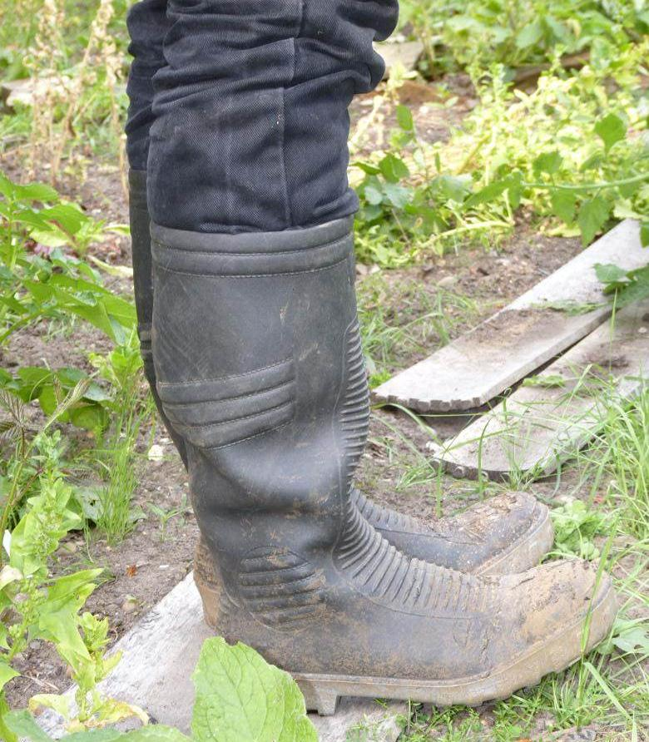
PROTECTIVE GEAR
PLANTWISE TRAINING. MODULE 2: PLANT HEALTHCARE. SAFE USE OF PESTICIDES : PROTECTIVE GEAR
Notes:
Boots are essential to keep the chemicals off your feet.

Slide 63
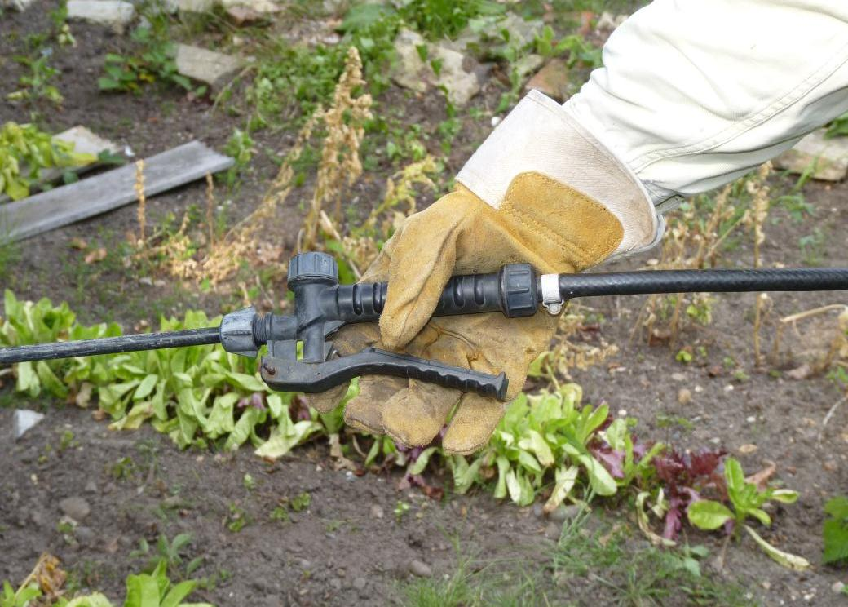
PROTECTIVE GEAR
PLANTWISE TRAINING. MODULE 2: PLANT HEALTHCARE. SAFE USE OF PESTICIDES : PROTECTIVE GEAR
Notes:
Gloves are useful to prevent accidental esposure on the hands but make sure they are washed regularly. These gloves are not ideal as they are absorbent.

Slide 64
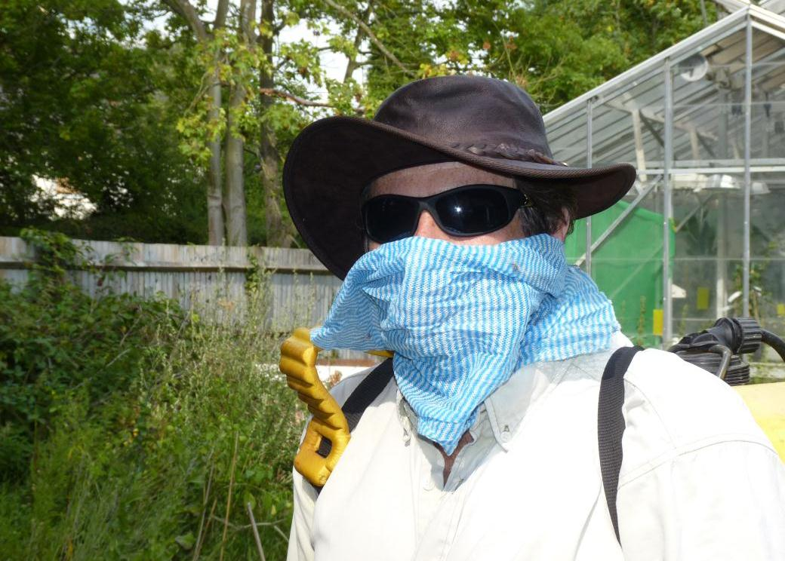
PROTECTIVE GEAR
PLANTWISE TRAINING. MODULE 2: PLANT HEALTHCARE. SAFE USE OF PESTICIDES : PROTECTIVE GEAR
Notes:
We would hope that in many countries is would be the minimum amount of protection that farmers would use. This does not give adequate protection but is much better than is used in many cases.
It is important to indicate that safetyware can give a false sense of security. You should not attempt to justify using the safety equipment by exposing yourself to more risk. This sound obvious but it is very common. Exercise on this coming up on the hazards of PPE

Slide 65
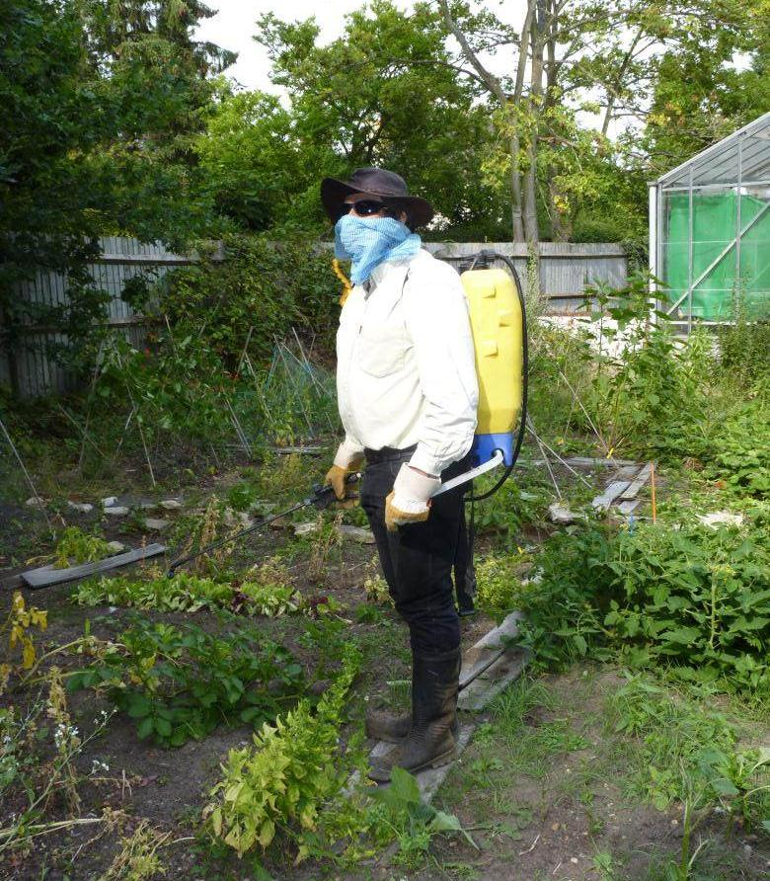
PROTECTIVE GEAR
PLANTWISE TRAINING. MODULE 2: PLANT HEALTHCARE. SAFE USE OF PESTICIDES : PROTECTIVE GEAR

Slide 66
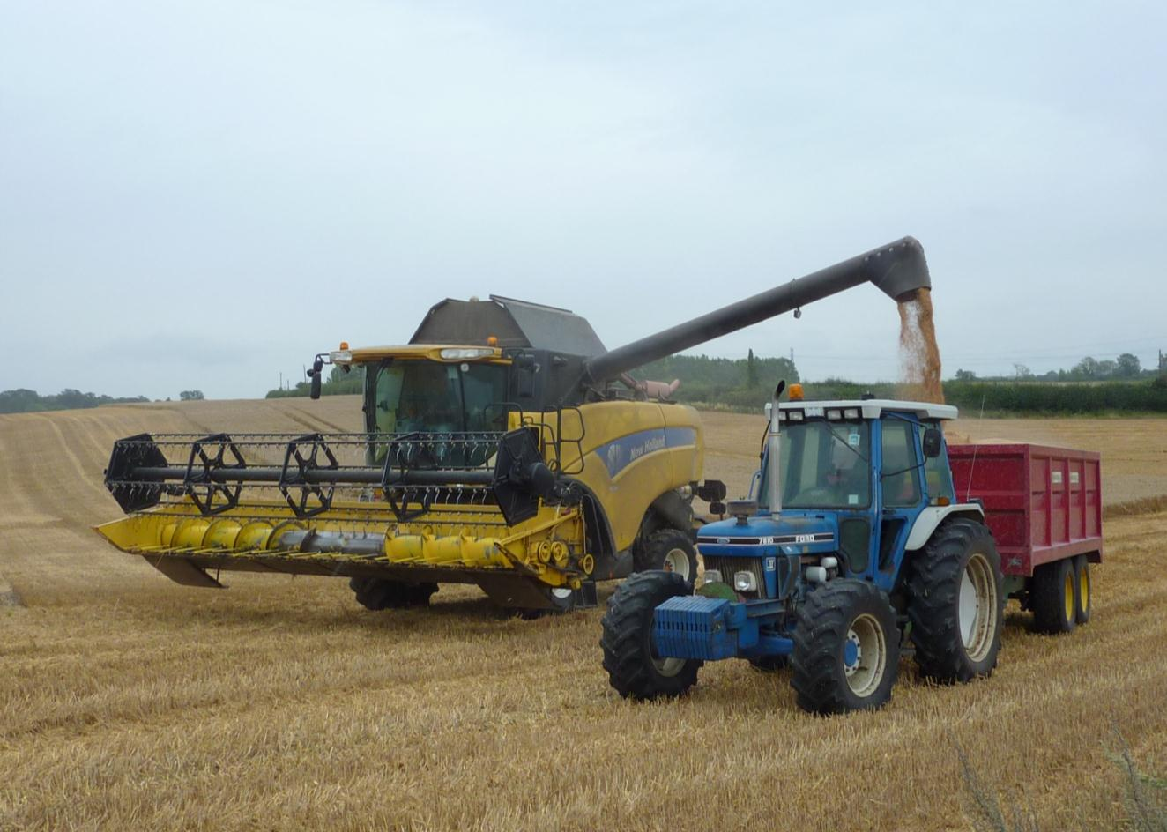
PROTECTIVE GEAR
Rules and regulations are tougher in the UK.
PLANTWISE TRAINING. MODULE 2: PLANT HEALTHCARE. SAFE USE OF PESTICIDES : PROTECTIVE GEAR
Notes:
The UK and many other countries have very strict rules on the safety equipment that must be worn when applying pesticides.
This is to show what kind of equipment could be used to achieve maximum protection.

Slide 67
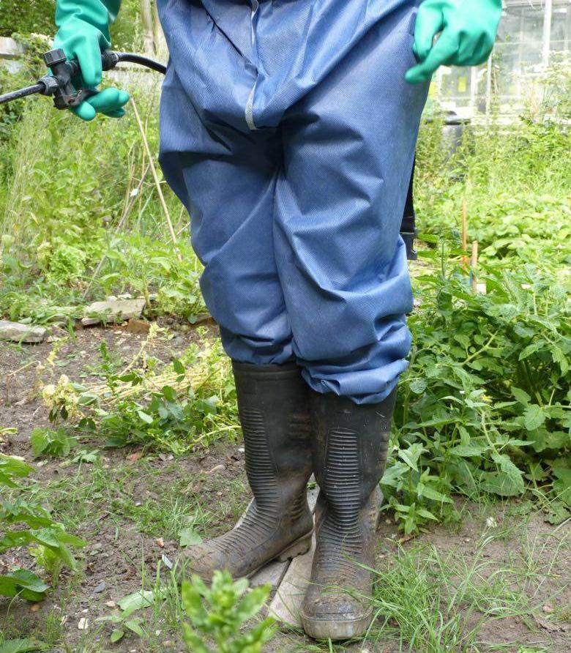
PROTECTIVE GEAR
PLANTWISE TRAINING. MODULE 2: PLANT HEALTHCARE. SAFE USE OF PESTICIDES : PROTECTIVE GEAR

Slide 68
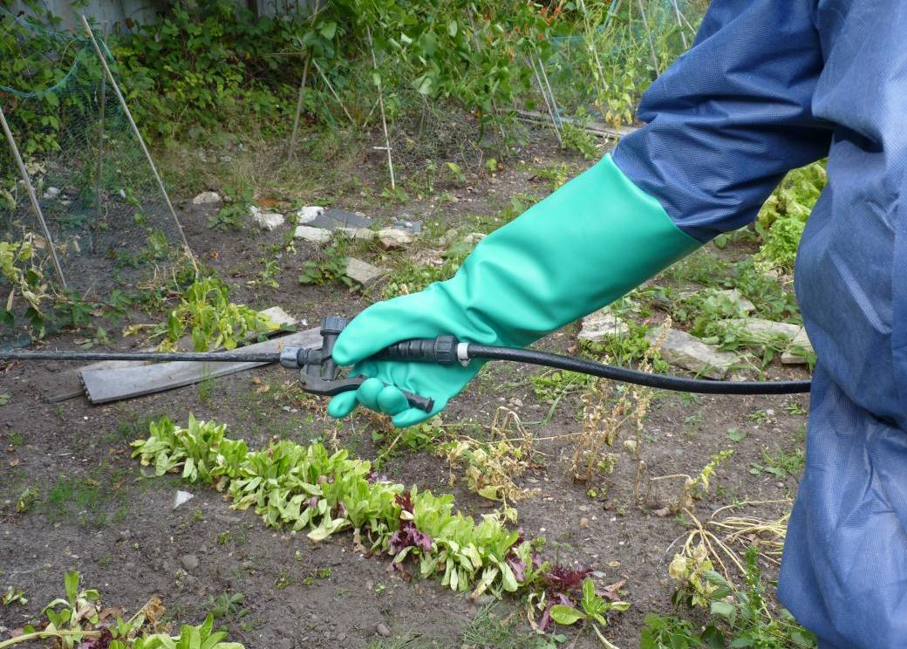
PROTECTIVE GEAR
PLANTWISE TRAINING. MODULE 2: PLANT HEALTHCARE. SAFE USE OF PESTICIDES : PROTECTIVE GEAR
Notes:
These gloves are high gauntlet gloves and are water proof. They offer the operator protection.

Slide 69
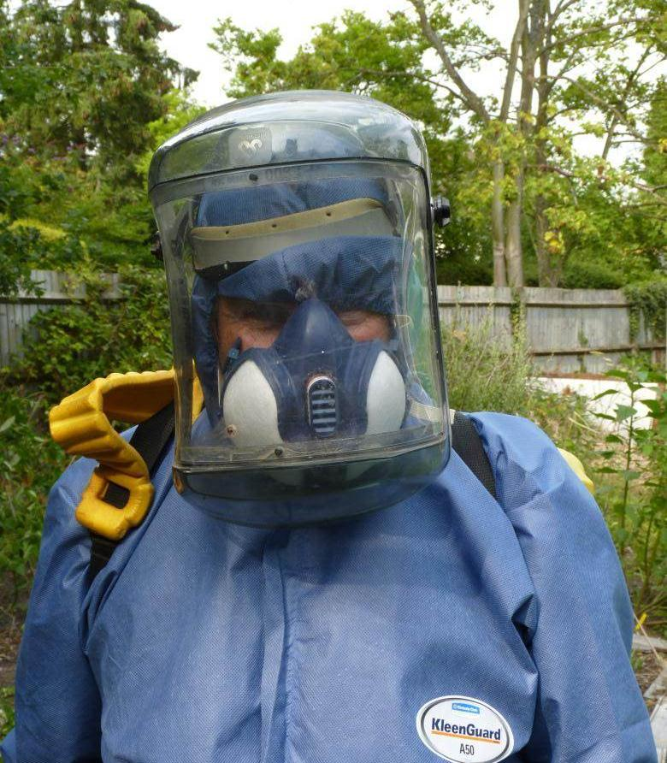
PROTECTIVE GEAR
PLANTWISE TRAINING. MODULE 2: PLANT HEALTHCARE. SAFE USE OF PESTICIDES : PROTECTIVE GEAR
Notes:
Face mask and respirator is probably a bit too much even for UK but it may be applicable in some cases.

Slide 70
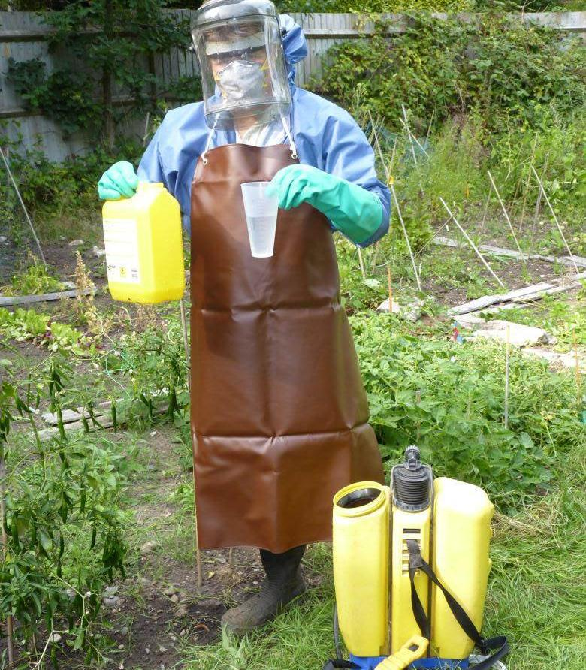
PROTECTIVE GEAR
PLANTWISE TRAINING. MODULE 2: PLANT HEALTHCARE. SAFE USE OF PESTICIDES : PROTECTIVE GEAR
Notes:
It is a good idea to use an apron when handling the concentrate chemcials.

Slide 71
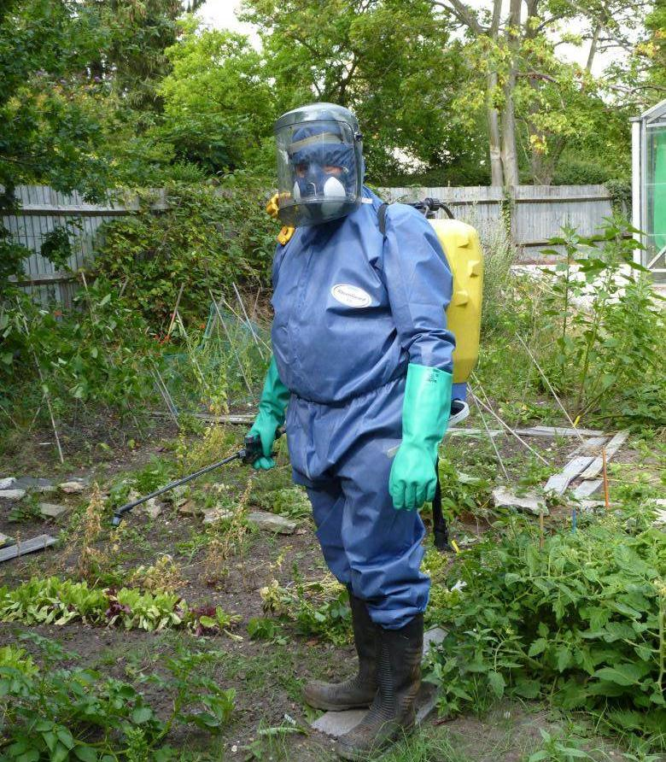
PROTECTIVE GEAR
PLANTWISE TRAINING. MODULE 2: PLANT HEALTHCARE. SAFE USE OF PESTICIDES : PROTECTIVE GEAR
Notes:
Hot and uncomfortable but it does protect the operator from the chemical. It does not protect those around him.

Slide 72
Thank you
Notes:
To obtain permission to use this presentation or any of its components, please contact plantwise@cabi.org

Slide 73
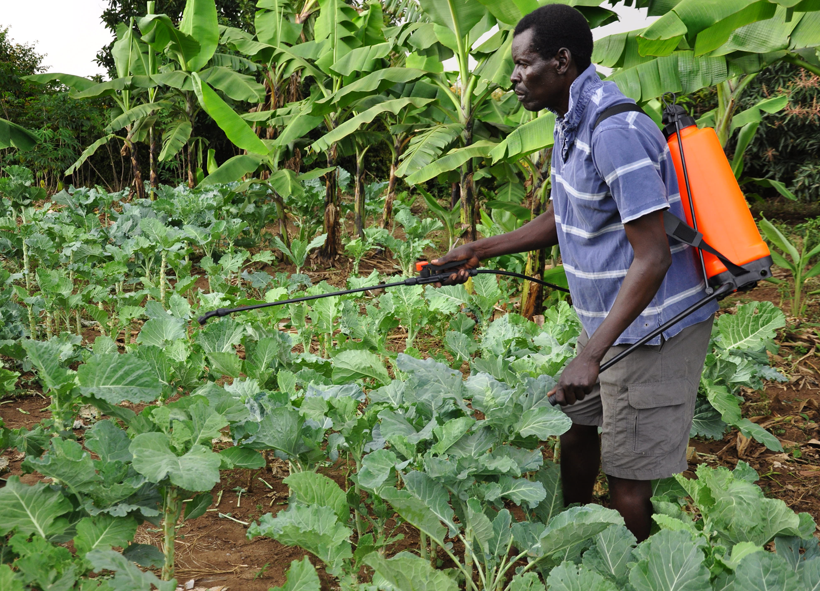
© CAB International 2012. All rights reserved.
No part of this publication may be reproduced in any form or by any means, electronically, mechanically, by photocopying, recording or otherwise, without the prior permission of the copyright owners.
Notes:
To obtain permission to use this presentation or any of its components, please contact plantwise@cabi.org

